Slide 1
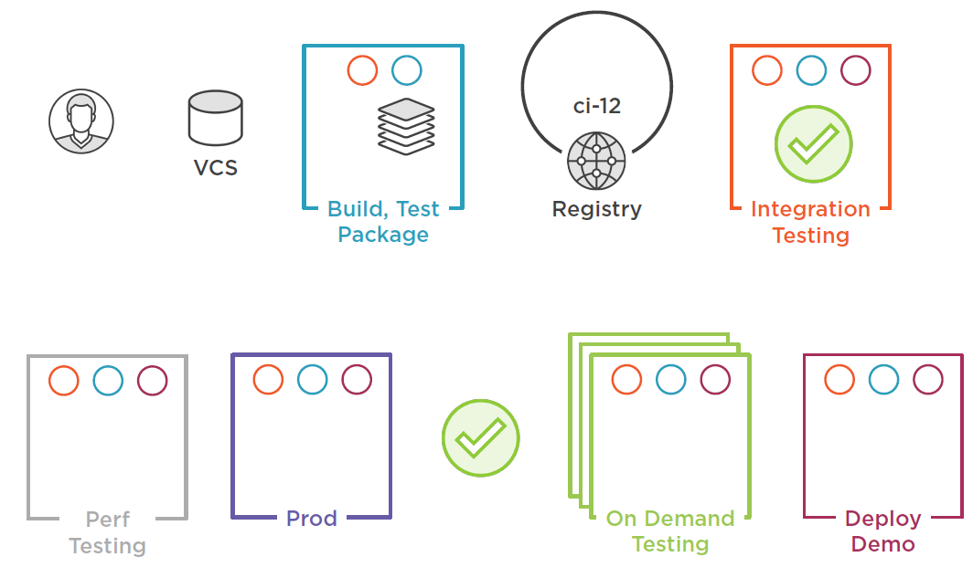
Build
Unit Tests
Create Image
-tag Image
-push Image
-Pull Tagged Image
-Run Tests
Run Software
- Run tests against
Out: Built Image
Pushed Image
Notes:
Traditional: Use source code to create a Publish folder, used to run .NET on top of runtime. No Containers involved.
Containers: Host need not have any build prerequisites (Dumb build agents). Container deals with details. Prepackaged build containers.
Option to place published app in a container to run
Stages:
Check-in
Build, Test and Package in a container
Push to Registry – tagged with build number – keep older versions
Advanced Integrating testing
App Demo: End-To-End
API – Generates random names
MailHog SMPT Server – sends list of random names
Integration test runner – validates email was sent
SST Builds
MSVP Utilities
Deploy Latest version – On Demand
One-Many Demo or Testing (QA, Sales, Bug demonstrations, etc.) environments on-demand
Deploy to Production
Customized via configurations
Engine X as reverse proxy
Performance
Dynamic Analysis
Extending CI Capabilities – Adding Resources:
Deploy to Multiple Nodes – Docker Swarm
Kubernetes

Slide 2
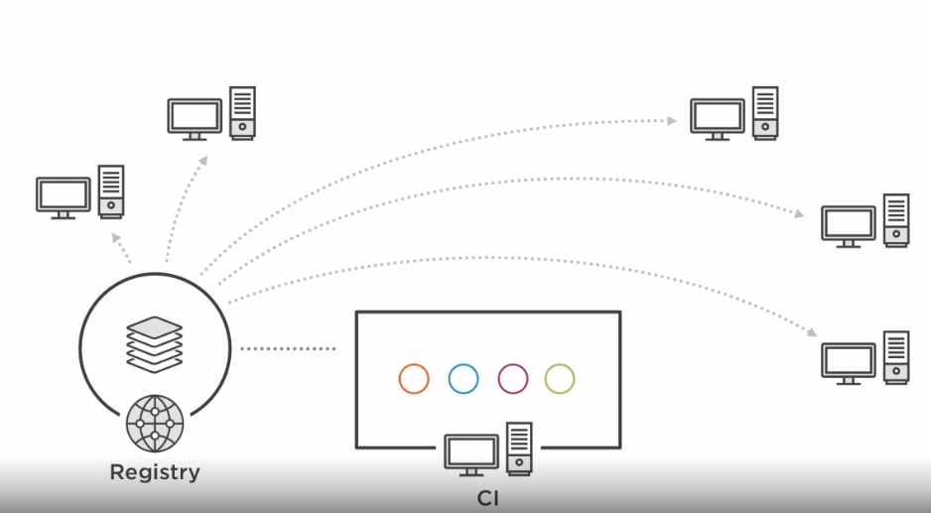
Simplest CI Infrastructure: Each running via Docker Container
Shared registry
CI Server (TeamCity, Jenkins works the same)

Slide 3
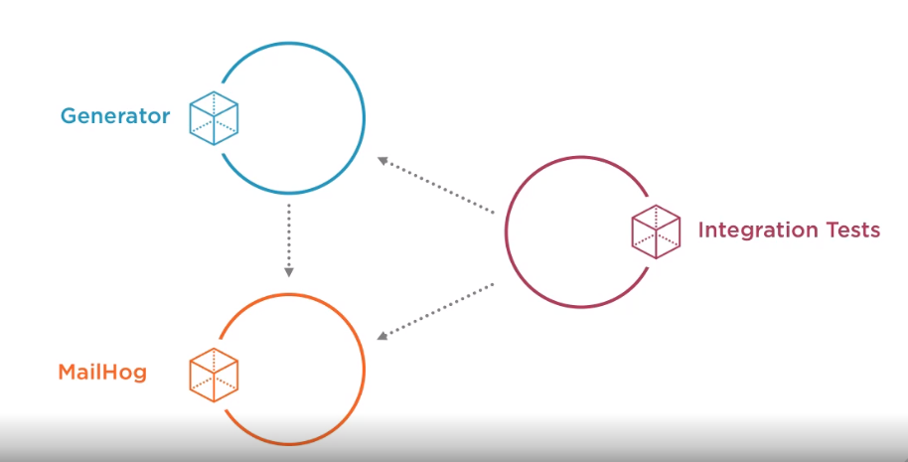
The APP
.NET CORE WebAPI
Generate Random Data API being tested
Unit tests and Dynamic Test
Email sent successfully?
Email contents validated
Random names present
Container
SMTP Server
Container
Container
Notes:
.NET App
NGINX web server

Slide 4
Build Test and Package
2
- Multi-Stage Docker File (generator-api)
# Build stage
FROM mcr.microsoft.com/dotnet/core/sdk:2.2 AS build-env
WORKDIR /generator
# restore
COPY api/api.csproj ./api/
RUN dotnet restore api/api.csproj
COPY tests/tests.csproj ./tests/
RUN dotnet restore tests/tests.csproj
# copy src
COPY . .
# test
RUN dotnet test tests/tests.csproj
# publish - note: will not occur unless test passes
RUN dotnet publish api/api.csproj -o /publish
# Runtime stage
FROM mcr.microsoft.com/dotnet/core/aspnet:2.2
COPY --from=build-env /publish /publish
WORKDIR /publish
ENTRYPOINT ["dotnet", "api.dll"]
Developing Project Docker File (generator-api\api)
1
Start Locally – create project, app, test suite. Make sure it works
Determine dependencies – packages, base Docker images etc.
Run via CMD line or IDE
Work out issues
> docker-compose up –d –build
# Build Stage
FROM microsoft/aspnetcore-build:2 AS build-env
WORKDIR /api
COPY api.csproj .
RUN dotnet restore
COPY . .
RUN dotnet publish -o /publish
# Runtime Image Stage
FROM microsoft/aspnetcore:2
WORKDIR /publish
COPY --from=build-env /publish .
ENTRYPOINT ["dotnet", "api.dll"]
> docker build -t testing .
> docker run --rm -it -p 8080:80 testing

Slide 5
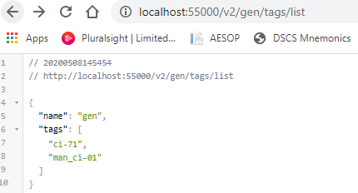
Tag Build
>>> Local Docker Images
docker build -t "localhost:55000/gen:man_ci-01" --no-cache .
^^ repo alias:tag^^
Push to Registry
>>> Hosted Registry
docker push localhost:55000/gen:man_ci-01
Registry website:
http:// localhost:55000/v2/_catalog
http://localhost:55000/v2/gen/tags/list

Slide 6
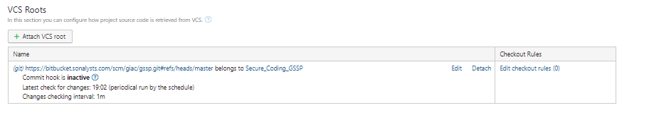
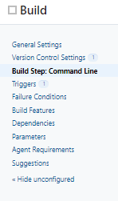
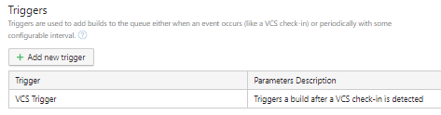
CI Server - Tie All Together
Web Hook – Sonalysts Bitbucket
Build Steps – Build & Test code, Tag & Push Image to Registry
image="localhost:55000/gen:ci-%build.number%"
docker build -t $image --no-cache .
docker push $image
triggered when branch changes

